Slide 1
SQL Join

Slide 2
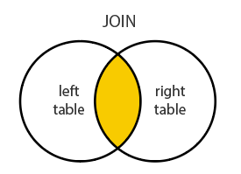
I, Join
A JOIN clause is used to combine rows from two or more tables, based on a related column between them.
SELECT <select_list> FROM TableA A
INNER JOIN TableB B
ON A.Key = B.Key

Slide 3
SQL JOIN Types
There are 6 types of Join
(INNER) JOIN: Select records that have matching values in both tables.
FULL (OUTER) JOIN: Selects all records that match either left or right table records.
LEFT (OUTER) JOIN: Select records from the first (left-most) table with matching right table records.
RIGHT (OUTER) JOIN: Select records from the second (right-most) table with matching left table records.
CROSS JOIN: is used to combine all possibilities of the two or more tables and returns the result that contains every row from all contributing tables
SELF JOIN

Slide 4
LEFT JOIN: The SQL LEFT JOIN returns all rows from the left table, even if there are no matches in the right table. This means that if the ON clause matches 0 (zero) records in the right table; the join will still return a row in the result, but with NULL in each column from the right table.
RIGH JOIN: returns all rows from the right table, even if there are no matches in the left table. This means that if the ON clause matches 0 (zero) records in the left table; the join will still return a row in the result, but with NULL in each column from the left table.
FULL JOIN : The combination of 2 commands above
SQL Server : Full join , Full outer join
MySQL : Using UNION ALL clause to combine

Slide 5


Slide 6
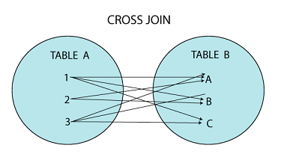


Slide 7
SELF - JOIN
-SELF JOIN is used to join a table to itself as if the table were two tables; temporarily renaming at least one table in the SQL statement.
-Basic syntax
SELECT a.column_name, b.column_name...
FROM table1 a, table1 b
WHERE a.common_field = b.common_field;

Slide 8
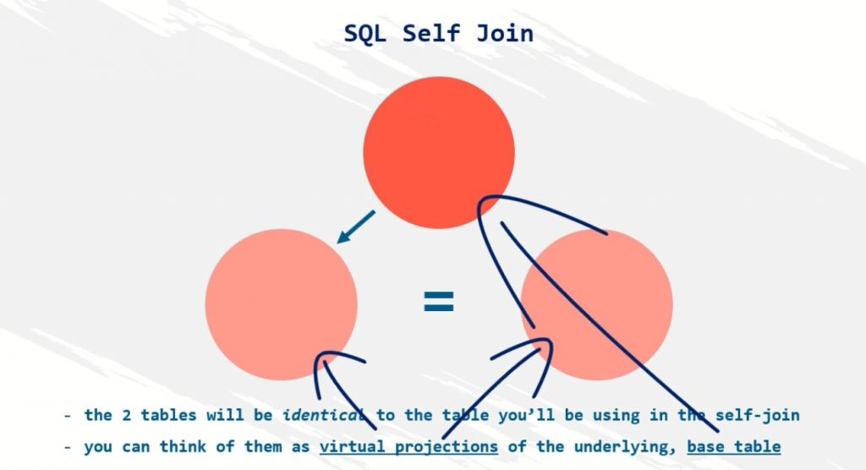
How it works????

Slide 9
Sub-queries
A Subquery or Inner query or a Nested query is a query within another SQL query and embedded within the WHERE clause.
A MySQL subquery is a query nested within another query such as SELECT, INSERT, UPDATE or DELETE. Also, a subquery can be nested within another subquery.
A subquery is used to return data that will be used in the main query as a condition to further restrict the data to be retrieved.
There are a few rules that subqueries must follow −
Subqueries must be enclosed within parentheses.
An ORDER BY command cannot be used in a subquery, although the main query can use an ORDER BY.
Subqueries that return more than one row can only be used with multiple value operators such as the IN operator.
The SELECT list cannot include any references to values that evaluate to a BLOB, ARRAY, CLOB, or NCLOB.
A subquery cannot be immediately enclosed in a SET function.
The BETWEEN operator can be used within the subquery.

Slide 10
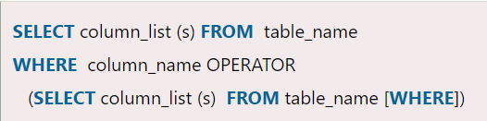
Subquery Syntax
The subquery (inner query) executes once before the main query (outer query) executes.
The main query (outer query) use the subquery result.

Slide 11
Subquery correlated
https://viblo.asia/p/subqueries-trong-mysql-L4x5xyVmKBM

